Slide 1

CUSTOMER CHURN PREDICTION
S.Koray Yıldız & Emrullah Ayaz

Slide 2

CONTENT
01
Problem Statement
02
Data Description
03
Data Processing
04
Model Explaning
05
Best Solution
06
Remarks & Results

Slide 3


Problem statement
Customer churn is the rate at which a customer stops using a service or application. It is a very important issue for companies because retaining existing customers is more cost-effective than acquiring new ones. Therefore, predicting customer churn in advance is a critical task for businesses.
This project aims to develop machine learning models to predict customer churn based on customer behavior, demographics, and transaction history. This way, companies can reduce churn by offering personalized deals and improved services to at-risk customers.

Slide 4

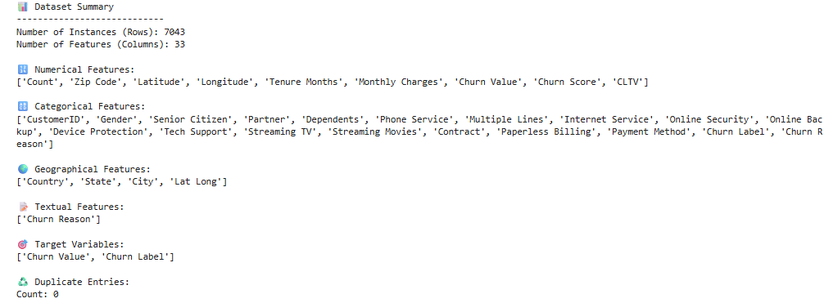
Data Description
This dataset is a tabular dataset containing information about 7,043 customers of a telecommunications company. It includes various details such as whether customers have churned, their reasons for leaving, the charges they paid, the locations they live in, and the services they received. The main goal is to use machine learning techniques to identify customers at risk of churning and to develop predictive models to help prevent customer loss.

Slide 5

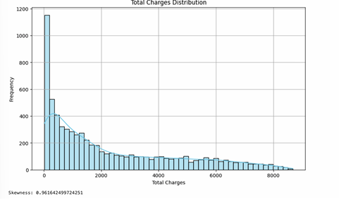
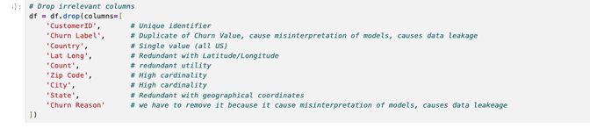
Data Processing

Slide 6

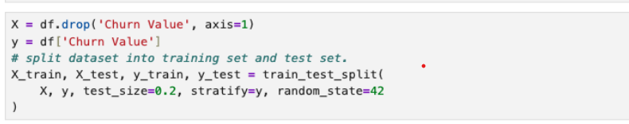
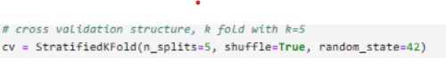
Model Explaining
Models
Logistic regression
Random Forest
XGBoost
Gradient Boosting
SVM
KNN
Why we choose stratified approach

Slide 7
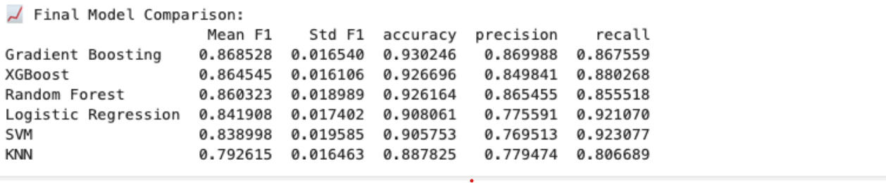

Model Selection and Training

Slide 8
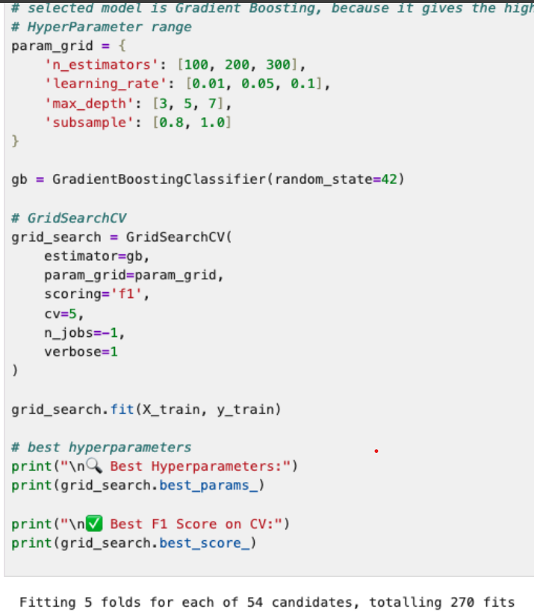

BEST SOLUTION - GRADIENT BOOSTING
FINE TUNING

Slide 9
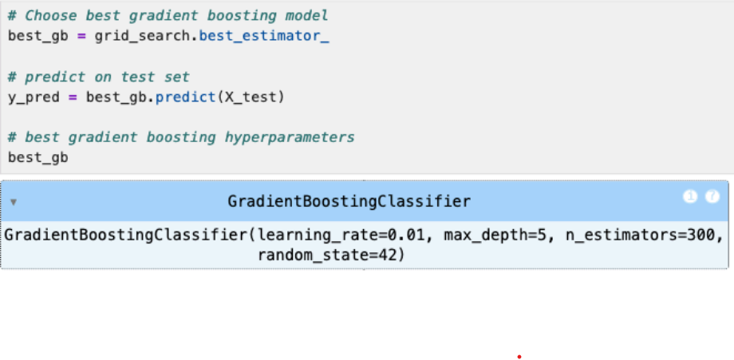

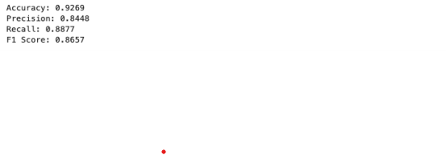
BEST GRADIENT BOOSTING MODEL
Testing With Best Model

Slide 10
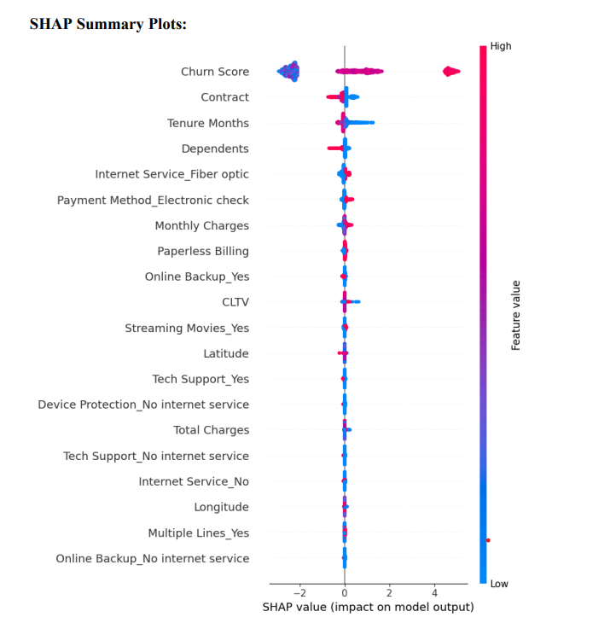
XAI-Global Explanations

Slide 11
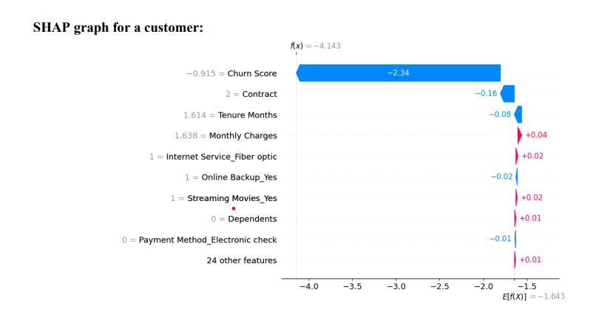
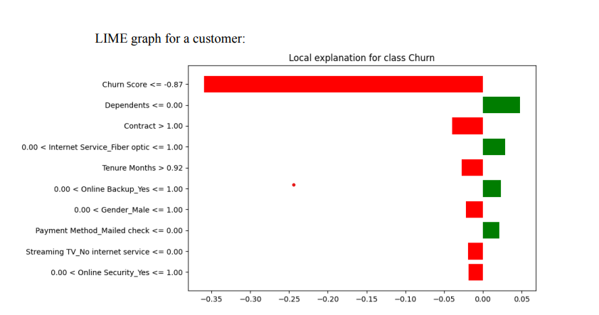
XAI-Local Explanations

Slide 12


Concluding remarks on the results

Slide 13


Thanks for
Listening!

